Slide 1
Ch 1.1:
Basic Mathematical Models; Direction Fields
Differential equations are equations containing derivatives.
Derivatives describe rates of change.
The following are examples of physical phenomena involving rates of change:
  Motion of fluids
  Motion of mechanical systems
  Flow of current in electrical circuits
  Dissipation of heat in solid objects
  Seismic waves
  Population dynamics
A differential equation that describes a physical process is often called a mathematical model.

Slide 2
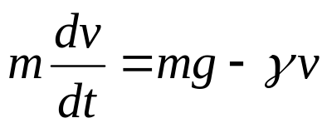
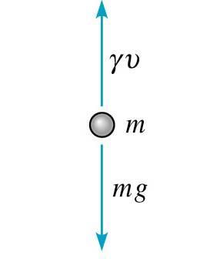
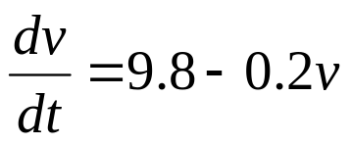
Example 1: Free Fall (1 of 4)
Formulate a differential equation describing motion of an object falling in the atmosphere near sea level.
Variables: time t, velocity v
Newton’s 2nd Law: F = ma = m(dv/dt) ←net force
Force of gravity: F = mg ←downward force
Force of air resistance: F = γ v ←upward force
Then
Taking g = 9.8 m/sec², m = 10 kg, γ = 2 kg/sec,
we obtain

Slide 3

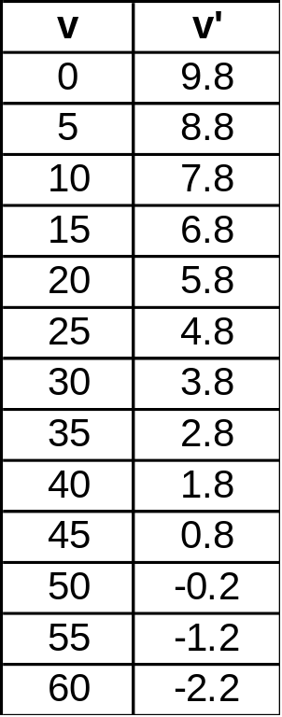
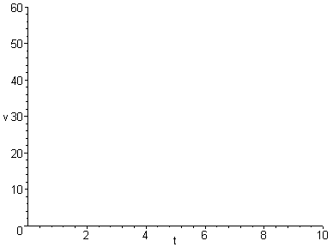
Example 1: Sketching Direction Field (2 of 4)
Using differential equation and table, plot slopes (estimates) on axes below. The resulting graph is called a direction field. (Note that values of v do not depend on t.)

Slide 4
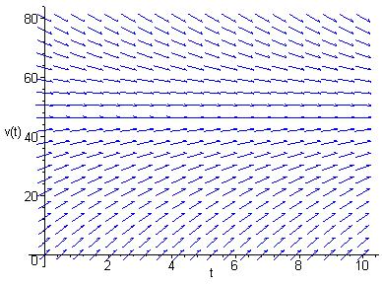
Example 1:
Direction Field Using Maple (3 of 4)
Sample Maple commands for graphing a direction field:
  with(DEtools):
  DEplot(diff(v(t),t)=9.8-v(t)/5,v(t),
  t=0..10,v=0..80,stepsize=.1,color=blue);
When graphing direction fields, be sure to use an appropriate window, in order to display all equilibrium solutions and relevant solution behavior.

Slide 5
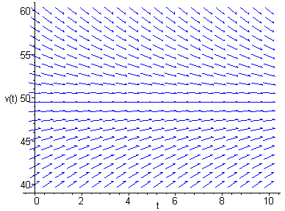
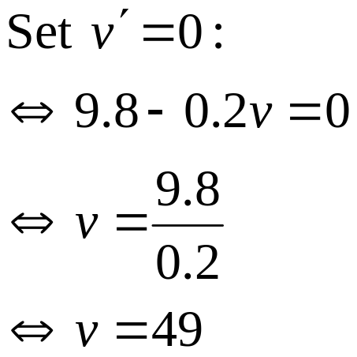
Example 1:
Direction Field & Equilibrium Solution (4 of 4)
Arrows give tangent lines to solution curves, and indicate where soln is increasing & decreasing (and by how much).
Horizontal solution curves are called equilibrium solutions.
Use the graph below to solve for equilibrium solution, and then determine analytically by setting v' = 0.

Slide 6

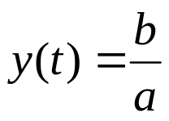
Equilibrium Solutions
In general, for a differential equation of the form
find equilibrium solutions by setting y' = 0 and solving for y :
Example: Find the equilibrium solutions of the following.

